Slide 1




Data-Driven and AI-Powered Lecture Hall Management System for Optimal Scheduling, Resource Allocation, and Future Prediction in University Operations
E.G.T.D.Egodage
BSc in Management Information Systems (Special)
21.1 Batch
Supervisor: Mr. Gayan Perera
Notes:
Good morning all of you.
I am Tharusha Dilhara and Today, I will be presenting my final year research project as a Data-Driven and AI-Powered Lecture Hall Management System for Optimal Scheduling, Resource Allocation, and Future Prediction in University Operations.

Slide 2



Background of the Study
    Rapid growth of student population creates scheduling challenges.
    UMIS is rule-based and lacks predictive capabilities.
    Research aim: Build an AI-powered, data-driven scheduling system.
    Technologies: Demand Forecasting (time‑series) + Intelligent Agent
Notes:
The background of my study is centered on a growing problem in faculty of computing at NSBM: with the rapid increase numbers of students, scheduling lecture halls has become more complex.
Currently, NSBM uses UMIS, which is rule-based. While useful, it cannot predict future demand or adapt to sudden changes, leading to inefficiencies.
My research aims to solve this by developing an AI-powered, data-driven scheduling system. Using technologies like time-series demand forecasting and intelligent agents, the system can predict peak times, prevent clashes, and adjust schedules in real time.

Slide 3


Research Problem/ Research Question
  Research Problems:
  Inefficient scheduling, hall allocation & conflicts.
  Lecture hall underutilization, high admin workload
  Research Question:
How can a data-based and AI-powered lecture hall management system improve responsiveness, efficiency, and accuracy of resource allocation in a changing university environment?
Notes:
The core problem is that NSBM faces inefficient scheduling, frequent conflicts, and underutilization of halls, which also increases the workload for administrators.
To address this, my research is driven by main key question:
How can an AI-powered, data-driven system improve responsiveness, efficiency, and accuracy in lecture hall allocation?
This question shaped the direction of the study and the design of the proposed system.

Slide 4
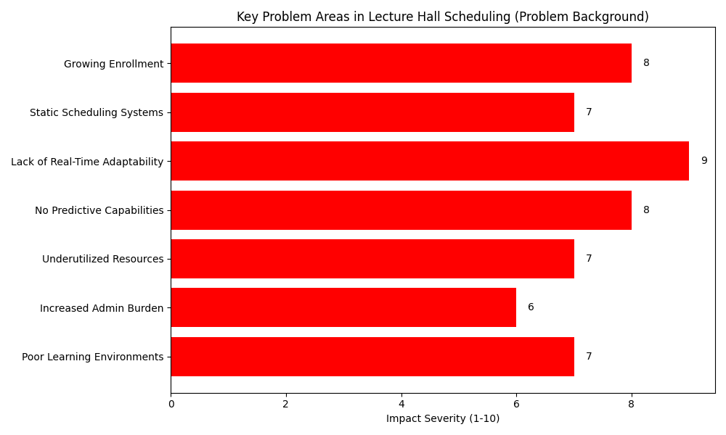

Literature Review (Findings)
  Traditional scheduling: manual/semi-automated, not scalable.
  Predictive Analytics: improves demand forecasting.
  Intelligent Agents: enable real-time adaptability.
  Gap: UMIS lacks predictive and adaptive features.
Problem Identification
Notes:
My literature review confirmed these challenges. Traditional scheduling methods are mostly manual or semi-automated, and they are not scalable.
Predictive analytics, however, has proven to improve demand forecasting, while intelligent agents enable real-time adaptability.
The key finding was that UMIS lacks these predictive and adaptive features, which highlights the research gap my project aims to fill.

Slide 5

Objectives Mapping to Features
  Identify hall scheduling constraints: Captures hall capacity, location, and resources
  Analyze UMIS gaps: Comparative analysis documented
  Develop AI-powered prototype: Predictive analytics + intelligent agents
  Evaluate performance: Testing with NSBM data & user feedback
Notes:
When I designed this system, I wanted to make sure that each research objective was not just theoretical but also connected to a real feature in the project
The first objective was to identify the key constraints in lecture hall scheduling. For this, the system captures details like hall capacity, location, and resources. This ensures we always know what halls are suitable for different modules.
Second one is objective was to analyze the existing UMIS system and highlight its gaps. That analysis guided me in deciding which features were missing and what improvements were needed.
third objective was to actually build an AI-powered system. Here, I used predictive analytics to forecast demand and intelligent agents to help manage scheduling conflicts.
Finally, to make sure everything worked in practice, I tested the system with demo data.

Slide 6






Research Methodology
Approach: Design Science Research
Data Collection: Historical timetables
Data Analysis: Python, Excel, Predictive modeling
Implementation: HTML/CSS/JS frontend, and Python/Flask backend
Notes:
this research followed the Design Science Research approach.
This included:
Identifying the problem, Designing and developing the system and Evaluating it through testing and feedback. I collected primary data past timetables and scheduling records.
In implementation:
The system was built using Python with Flask for the backend, and HTML, CSS, and JavaScript for the frontend.
The backend runs the predictive models and the genetic algorithm for scheduling.
The frontend provides a user-friendly interface for administrators, lecturers, and students.
Administrators can generate and manage schedules, lecturers can view their allocated halls, and students can easily access their timetables.

Slide 7


Proposed Solution
  AI-powered Lecture Hall Management System
  Predict demand with time-series analysis
  Provide real-time adaptability with intelligent agents
  Outcome: Reduce conflicts, maximize hall usage, enhance satisfaction
Notes:
The proposed solution is an AI-powered Lecture Hall Management System designed to make scheduling smarter and more efficient.
It has 3 key features:
demand prediction using time-series analysis to forecast hall usage, and real-time adaptability through intelligent agents that handle last-minute changes automatically. And Optimize schedules using Genetic Algorithms
The outcomes are reduced scheduling conflicts, better hall utilization, and improved satisfaction for administrators and lecturers.
In short, this solution addresses the inefficiencies of the current system by introducing predictive and adaptive intelligence.

Slide 8



System Design for Lecture Hall Management System
Core Components
Historical Data
Inputs
Predictive
Analytics Engine
Outputs
Historical Data
& Real-Time Demand
Optimized
Schedules
& Visual Reports
Genetic Algorithm
Module
Intelligent
Agents
Notes:
This slide shows the system design of Lecture Hall Management System. The system starts with inputs, which include both historical data and real-time demand. Historical data helps us understand past usage patterns, while real-time demand shows the current scheduling needs. These inputs are then processed by three main core components.
First, the Predictive Analytics Engine, which forecasts future demand and identifies peak times.
Second, the Genetic Algorithm Module, which generates optimized timetables by minimizing conflicts and improving resource usage.
And third, the Intelligent Agents, which handle tasks like real-time updates and sending alerts to users.
Finally, the system produces outputs, which are optimized schedules and visual reports. These outputs make it easier for administrators, lecturers, and students to clearly see hall usage and manage scheduling efficiently.

Slide 9
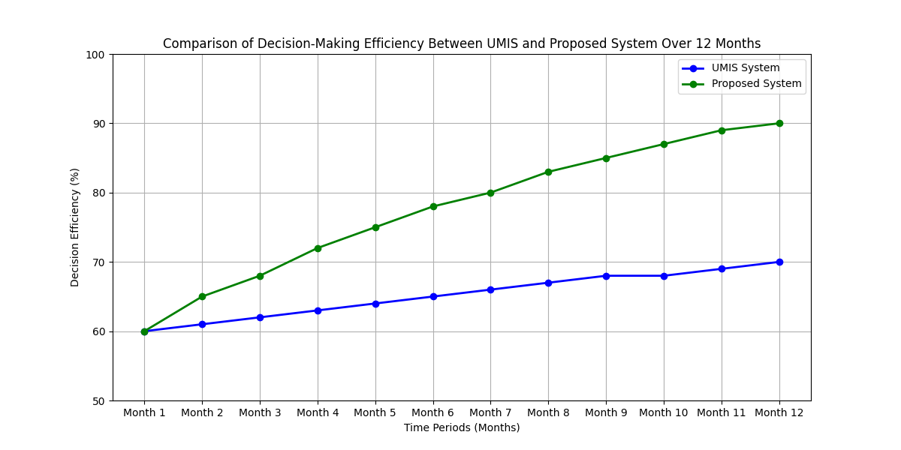
Data Analysis
  Survey: Identified frequent conflicts, overcrowding, underutilization
  Historical data: Peak demand during exams & semester start
  Patterns: Specific halls over-booked, others underused
  Analysis supported predictive demand modeling
Notes:
Data analysis played a key role in shaping the system. From surveys, I found that conflicts and overcrowding were common issues. From historical timetable data, I identified peak usage times, such as exam periods and semester starts. These insights were used to train the predictive model so that the system could anticipate hall demand in advance.

Slide 10
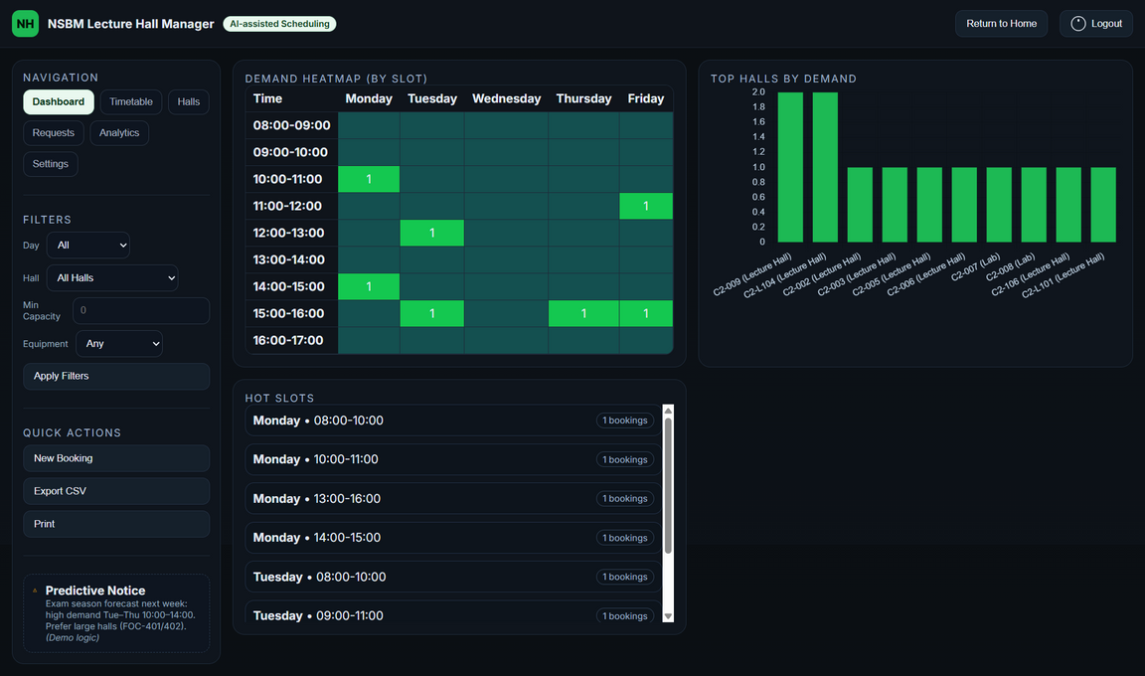
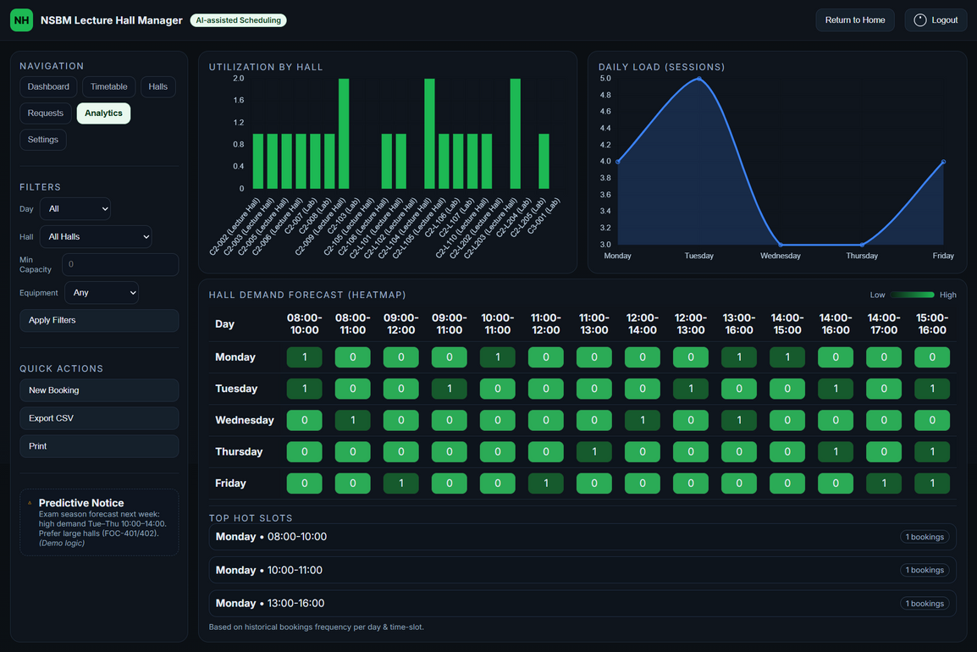
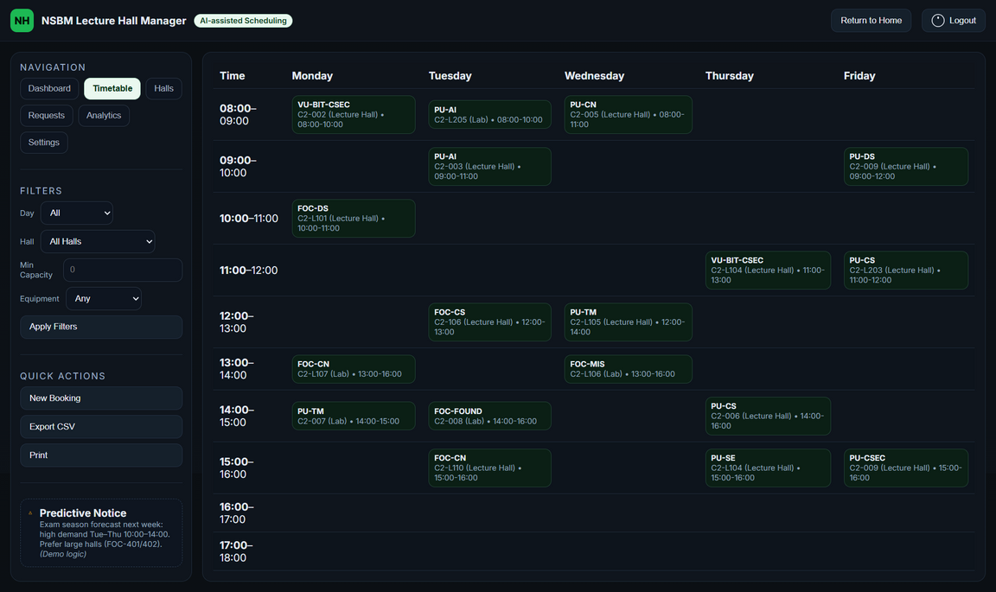
Results
  Predictive analytics forecasted demand peaks effectively
  Improved hall utilization compared to UMIS
  Genetic algorithm optimized timetables → minimized conflicts
Notes:
The results were very encouraging: The predictive model successfully forecasted hall demand trends. The genetic algorithm generated timetables that minimized conflicts and improved hall utilization. Compared to UMIS, this system provided more accuracy, and efficiency.

Slide 11




Conclusion
  Research objectives achieved: Predictive, optimized hall allocation
  Problems addressed: Inefficiency, conflicts, and underutilization
  Contribution: Scalable AI-based framework for universities
  Business Insight: Applicable to corporates, hospitals, events
  Future Work: Backend integration, mobile app, advanced ML models
Notes:
In conclusion, The system improves scheduling accuracy, reduces conflicts, and ensures better use of university resources.
It also contributes to the field by providing a scalable, AI-based framework for academic scheduling.
Beyond universities, the concept can be applied to other fields like corporate training centers, conference management, and hospitals.
For future work, I recommend full real-time integration with university systems, developing a mobile app, and expanding the scope to include labs and equipment scheduling.

Slide 12
Thank You
15th September 2025
Click here for Live Demo
Notes:
Thank you for your attention. Now, I would like to move on to the live demonstration of my development project

